Slide 1
Chapter 4 figures

Slide 2
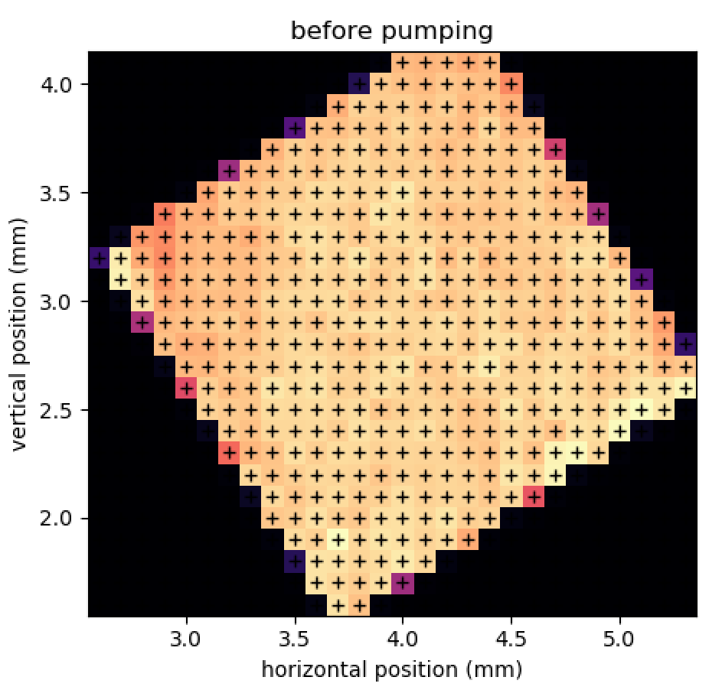
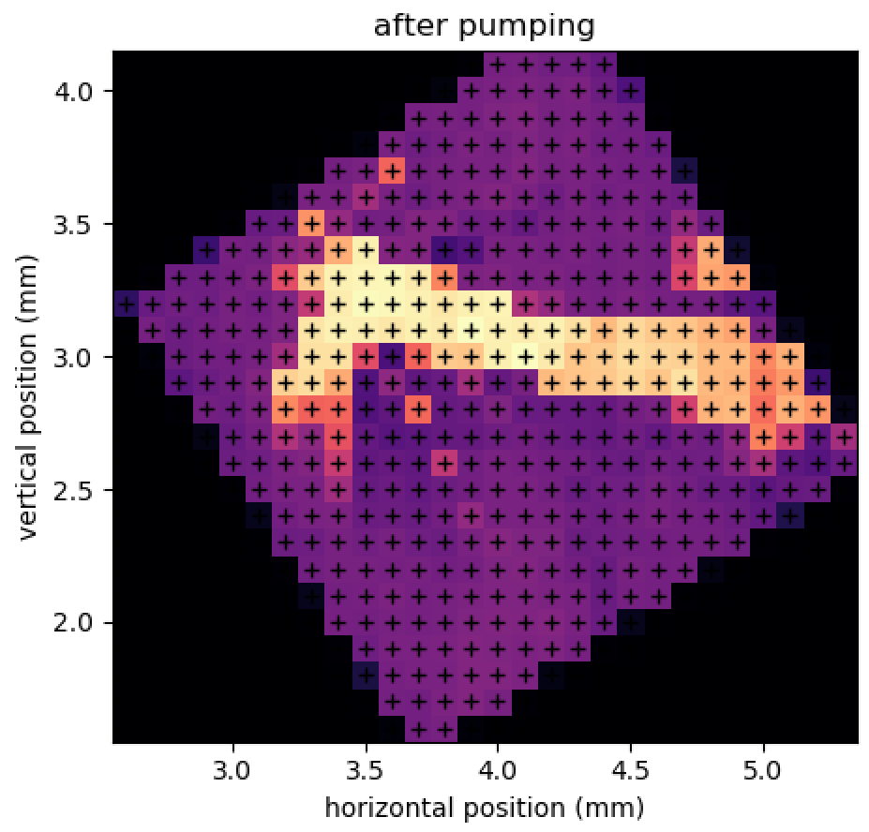
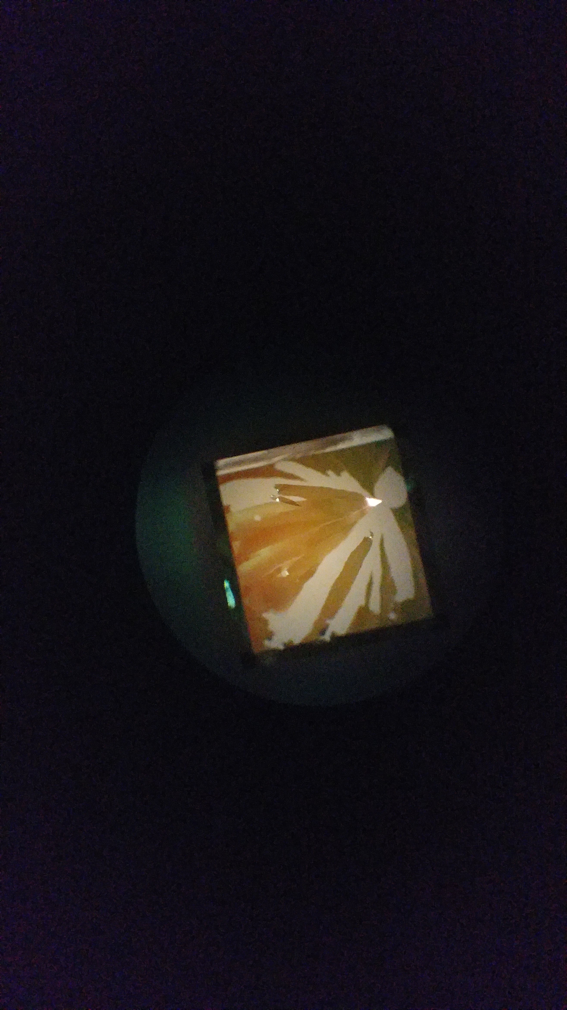
200 nm Si
200 nm Si
200 nm Si
IR-pumped areas
microscope image
Notes:
Figures from 2019-04-19 powerpoint presentation … “before pumping” was 4/09/2019 map1. “after pumping” was 4/10/2019 map1.

Slide 3
Imaging the samples under vacuum
C
1 inch
HM
FM
SH
1 inch
L

Slide 4
Si, 260 nm
Si, one hole <200μm
“popped” 30 nm SiN

Slide 5
C
1 inch
HM
FM
SH
1 inch
L
Si, 260 nm
Si, one hole <200μm
“popped” 30 nm SiN
200 nm Si
200 nm Si
200 nm Si
IR-pumped areas
microscope image

